Slide 1
Subsea Services Inc.
Website Development
Round 3 Comments
15 Sep 2016

Slide 2
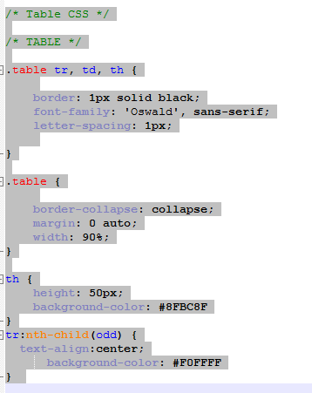
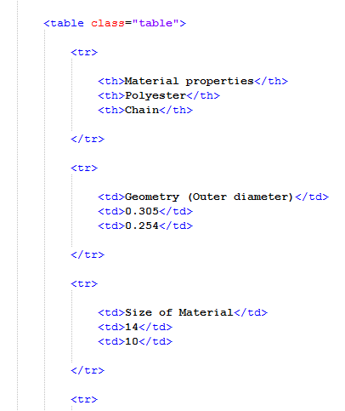
Table’s in Web report
In the web report the tables added from the below location:
Dropbox\0119 Programming\Cal\017-0023-01 Report Tables.xlsx
CSS CODE:

Slide 3
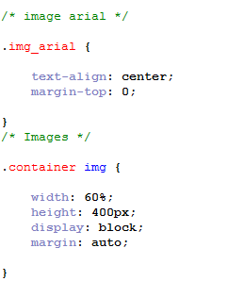
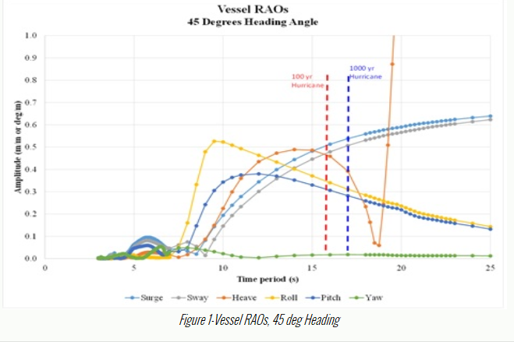
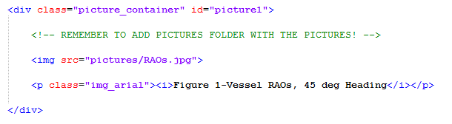
Pictures in Web report
In the web report the pictures added with help of below code:

Slide 4
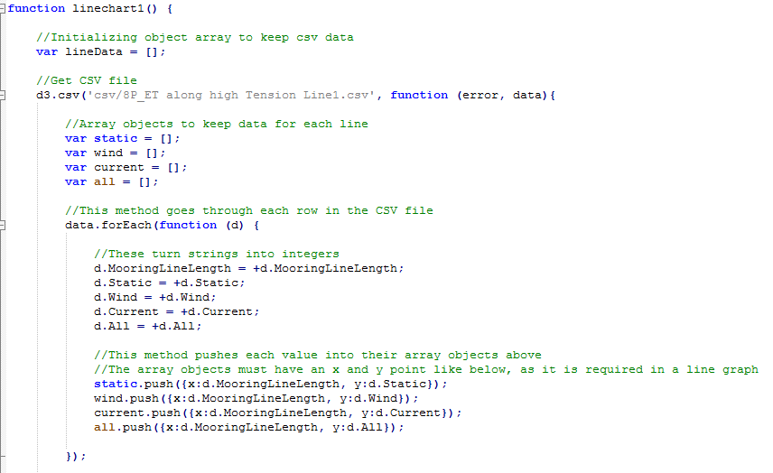
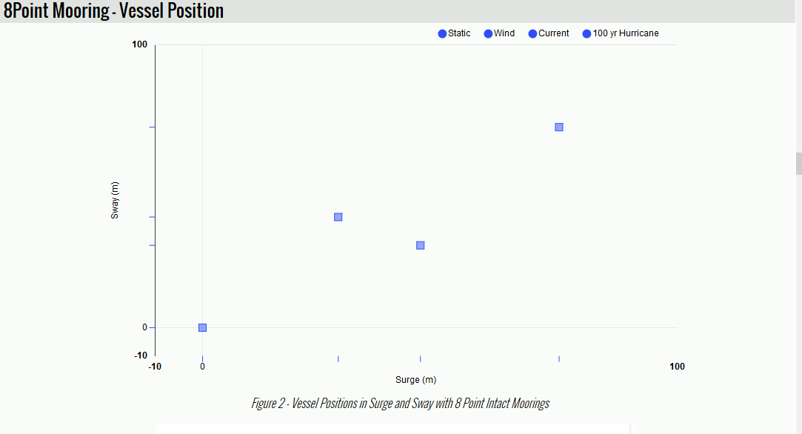
CSV in Web report
In the web report the CSV files added with using js script

Slide 5
THANK YOU
For the opportunity to serve!

Slide 6
Document Revision History
01 | Round 2 comments. Round 1 comments in PRE-0006-01 | 12 Sept 2016 |  | GSY | VA
Rev | Description | Date |  | Author | Checked | Approved
Document No: |  |  | Client Ref:
0119-PRE-0007-01 |  |  | n/a

